Slide 1
THIAGARAJAR COLLEGE OF ENGINEERING, MADURAI
DEPARTMENT OF ECE
22EC690 –PROJECT- IlI
Review – I
GIS-BASED SPATIAL ANALYSIS OF GROUNDWATER QUALITY PARAMETERS FOR WATER RESOURCE ASSESSMENT IN MADURAI DISTRICT,SOUTH INDIA
Presented By,
2403917710621077 –SARAN KUMAR S
240391771062046 –LOGESHKUAMR C
240391771061082-SRI RAM.S.B
Guided By,
Dr. R. A. ALAGURAJA
Professor/ ECE

Slide 2
Introduction
Groundwater quality is assessed using Total Dissolved Solids (TDS), Sodium (Na), Magnesium (Mg), and Chloride (Cl) and many parameters from the data set
These parameters indicate the chemical characteristics and suitability of groundwater.
GIS is used to map and analyze the spatial variation of these parameters across Madurai District.
Spatial analysis helps identify areas with good and poor groundwater quality.
The results support water resource planning, groundwater management, and decision-making for sustainable use.

Slide 3
Motivation
Groundwater is the major source of drinking and irrigation water in Madurai District.
Increasing urbanization, agriculture, and industrial activities affect groundwater quality.
Monitoring water quality is essential to ensure safe and sustainable water use.
GIS provides an efficient tool to analyze and visualize the spatial distribution of groundwater quality.

Slide 4
Existing System Analysis
Groundwater quality is analyzed using conventional field sampling and laboratory testing methods.
Water quality parameters such as TDS, Na, Mg, and Cl are evaluated separately.
Results are typically presented in tabular or report format without spatial visualization.
Spatial variation and contamination patterns are difficult to identify.
Manual data analysis is time-consuming and less efficient for large study areas.
Limited support for effective groundwater quality assessment and resource management.

Slide 5
Tools used:
QGIS – Open-source GIS software used for spatial analysis, interpolation, and thematic map generation.
Shapefile (.shp) – Contains the Madurai district boundary and sampling locations used as the base layer for mapping.
Groundwater Quality Dataset – Includes TDS, Sodium (Na), Magnesium (Mg), and Chloride (Cl) values with corresponding coordinates.
Coordinate Reference System (CRS) – Used to accurately georeference and display spatial data.

Slide 6
Scenario 1: Drinking Water Quality
Assess drinking-water suitability based on the chemical composition of groundwater.
pH, TDS indicate acidity, alkalinity and dissolved-salt levels.
F, NO₂/NO₃ help identify potential health-related contamination.
Ca, Mg, Cl, SO₄ & Na indicate hardness, salinity and overall water acceptability.
Spatial analysis identifies good, moderate and poor-quality zones across Madurai District.
Final application: Identify safe zones and map areas requiring water-quality monitoring.

Slide 7
Scenario 2:Agriculture / Irrigation
Scenario: Assess groundwater suitability for irrigation and its effects on soil and crops.
Key Parameters: TDS, SAR, RSC, Na%, Cl, Ca & Mg
Major Impacts: High salts → soil salinity; high sodium → poor soil permeability; high Cl → crop
toxicity.
What We Identify: Suitable, moderate and unsuitable irrigation zones.
Applications: Irrigation planning → Crop/soil risk assessment → Sustainable groundwater
management.

Slide 8
Scenario 3: Human Health
Scenario: Assess groundwater parameters that may pose potential health risks through long-term
consumption.
Key Parameters: F, NO₂/NO₃, TDS, Na, pH, SO₄ & Cl
Major Impacts: Excess F → fluorosis risk; high NO₃/NO₂ → health concern; very high TDS/Na →
mineral/sodium exposure concern.
What We Identify: Low, moderate and high potential health-risk zones.
Applications: Water-quality monitoring → Risk-zone mapping → Public-health planning.

Slide 9
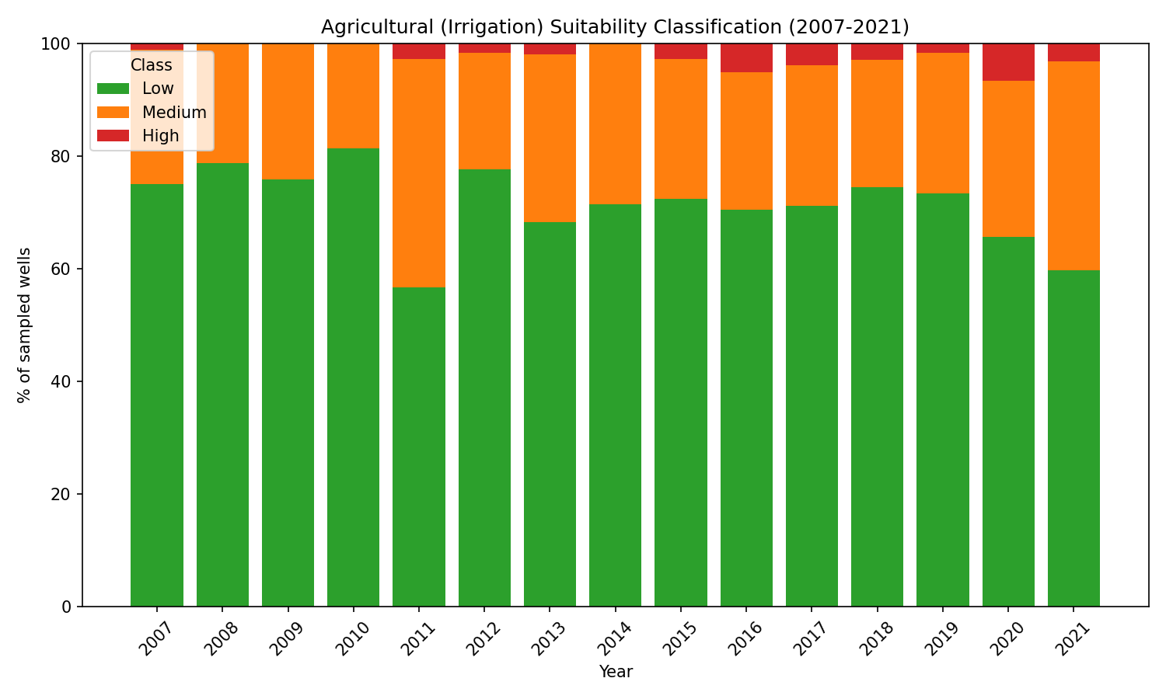
Agricultural (Irrigation) Suitability Classification

Slide 10
Agricultural (Irrigation) Suitability Classification
Low suitability dominates most years, indicating limited groundwater suitability for irrigation.
Low class: approximately 57–82%, highest around 2010.
2011: noticeable improvement, with Medium suitability increasing.
2012–2021: Low suitability remains dominant but shows a gradual decline toward 2021.
High suitability: generally <5%, representing very few highly suitable wells.
Overall: Groundwater requires better monitoring and sustainable irrigation management.

Slide 11
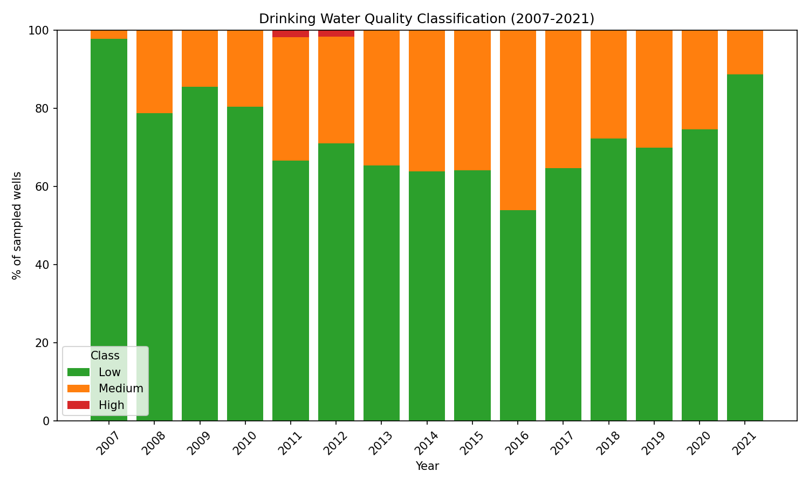
Drinking Water Quality

Slide 12
Drinking Water Quality Classification
Low-quality wells dominate, indicating poor drinking-water suitability in many locations.
2016: Poorest condition, with Low quality around 54%.
2018–2021: Low-quality wells increase, reaching about 89% in 2021, indicating deterioration.
High-quality wells remain limited, mainly during 2011–2015.
Overall: Significant year-to-year variation highlights the need for continuous monitoring and
groundwater management.

Slide 13
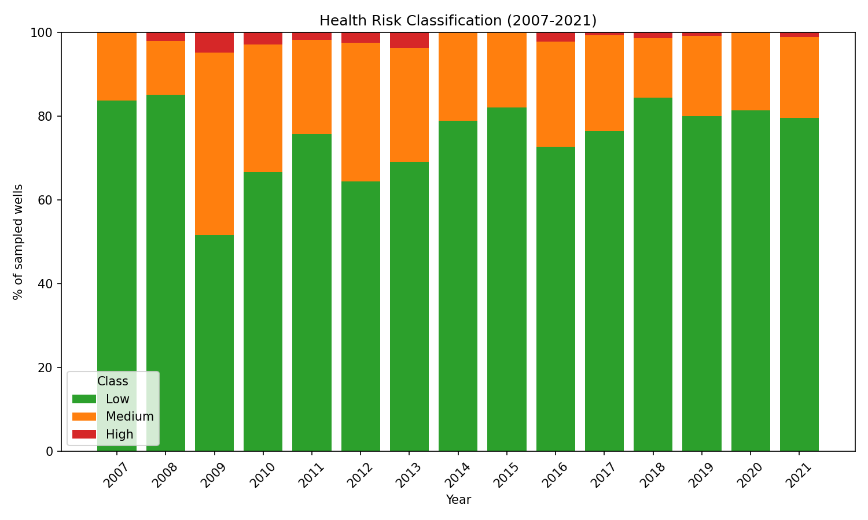
Health Risk Classification

Slide 14
Health Risk Classification
Low-risk wells dominate most years, indicating generally acceptable groundwater conditions.
2009: Lowest Low-risk level (~51%) with Medium-risk rising to ~44%
.
2011–2021: Low-risk generally remains above 64%, reaching ~85% in 2018.
High-risk wells remain low (generally 0–4%) but increase in some years.
Overall: Most wells show low health risk, but periodic Medium/High-risk zones require
continuous monitoring and treatment.

Slide 15
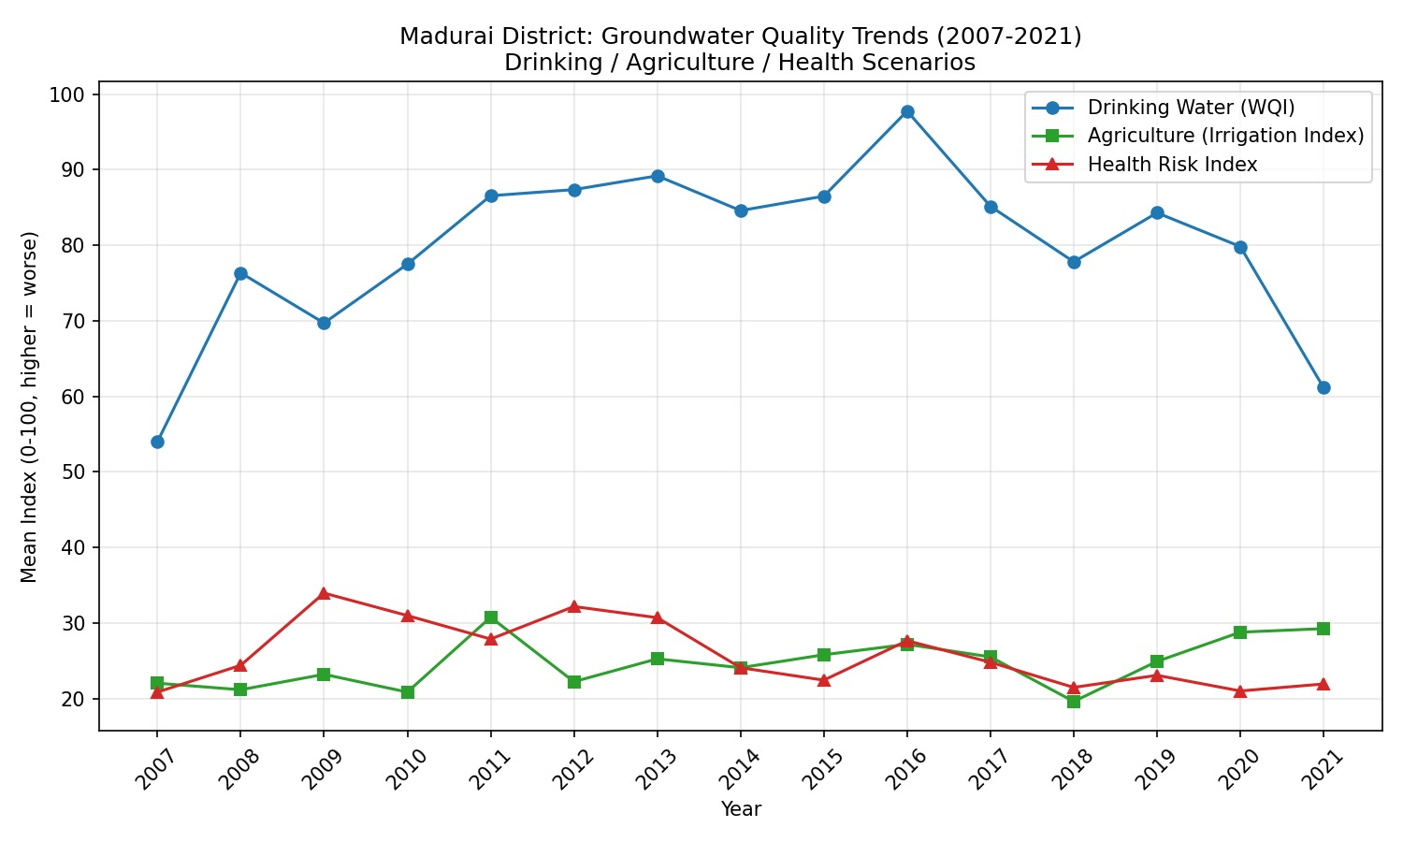
Interrelationship of Groundwater Quality, Agriculture & Health (2007–2021)

Slide 16
Interrelationship of Groundwater Quality, Agriculture & Health (2007–2021)
Poorer groundwater quality (higher WQI) is associated with higher health risks.
WQI and Health Risk Index exhibit a strong positive correlation over the study period.
2016 recorded the worst groundwater quality and one of the highest health risk levels.
Agricultural suitability remained relatively stable and was less affected by groundwater quality changes.
Improving groundwater quality can reduce health risks and support sustainable water resource management.
Inference: Groundwater quality has a greater impact on human health than on agricultural suitability.

Slide 17
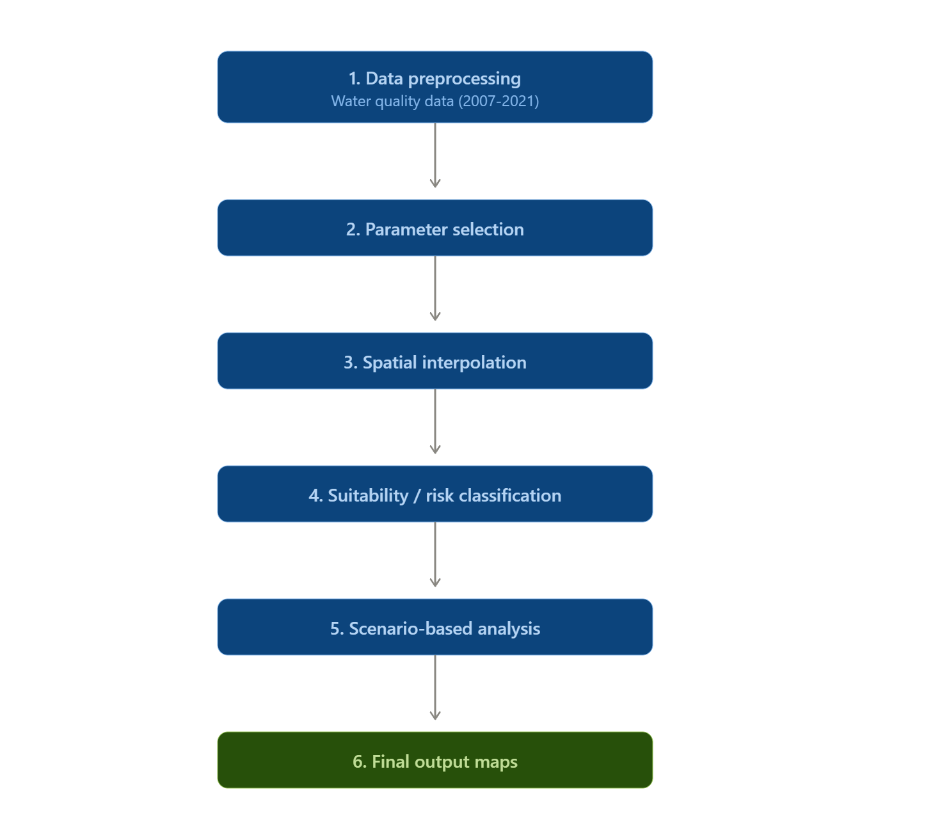
Methodology

Slide 18
Expected Outcomes & Deliverables:
GIS-based thematic maps showing the spatial distribution of TDS, Na, Mg, and Cl.
Identification of groundwater quality zones and contamination-prone areas in Madurai
District.
Spatial analysis report for groundwater quality assessment.
QGIS project files and Shapefiles containing the analyzed spatial data.
Final project report and presentation for water resource planning and decision-making.

Slide 19
Conclusion
Groundwater quality varies spatially and temporally (2007–2021).
Drinking & irrigation suitability is generally low, indicating quality concerns.
Health risk is mostly low, with some medium/high-risk areas.
Spatial interpolation identifies vulnerable zones effectively.
Supports monitoring, treatment, and sustainable groundwater management in Madurai District.

Slide 20
THANK YOU

